Slide 1



COIN:
A system for COnstructing and vIsualizing kNowledge graph
SEIIIMaskOn
181250092 刘子仰
181250007 曾昭宁
181250074 李炫晔
181250129 檀潮

Slide 2
menu
Gitlab activity
Front-end
Back-end
Show demo

Slide 3
Gitlab
activity

Slide 4
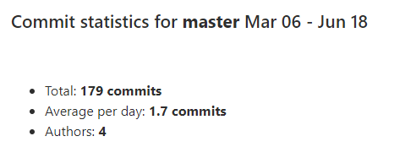

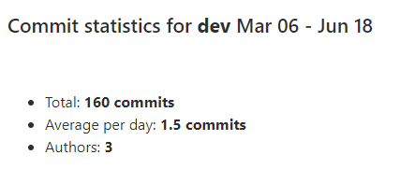

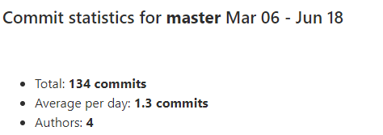
Gitlab Commit

Slide 5
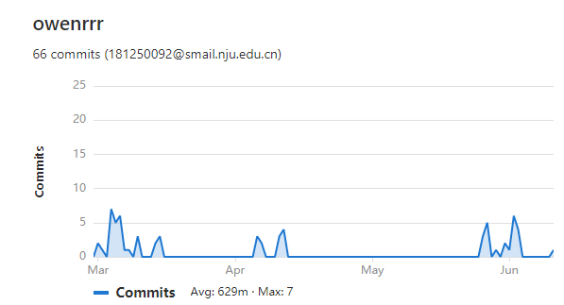
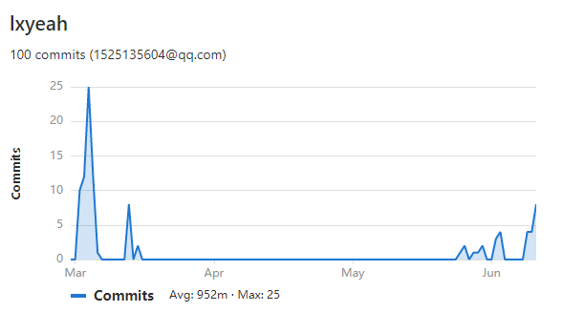
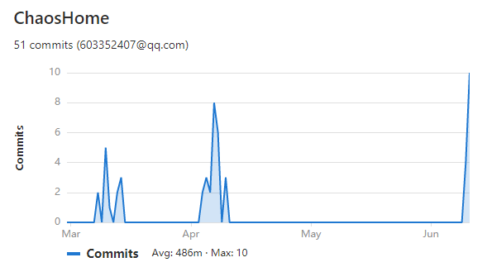
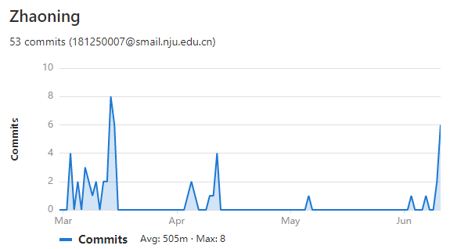
contributor

Slide 6
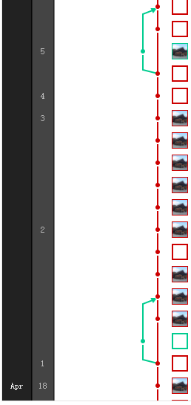
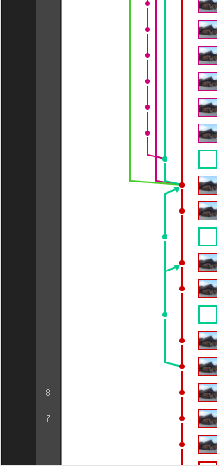
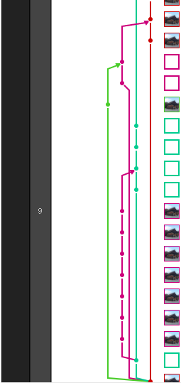
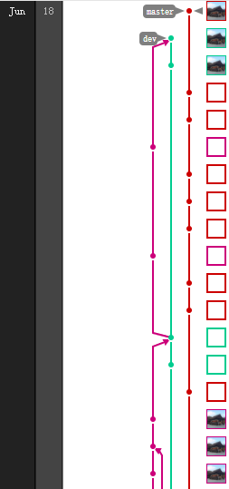
Branches

Slide 7
Front-end

Slide 8
Technique
1. 平台：Vue + Vuex
2. 绘图：Cytoscape.js

Slide 9
Design IDEA
1. Keep it simple
2. 聚集同类的部件
3. 符合人的阅读习惯

Slide 10
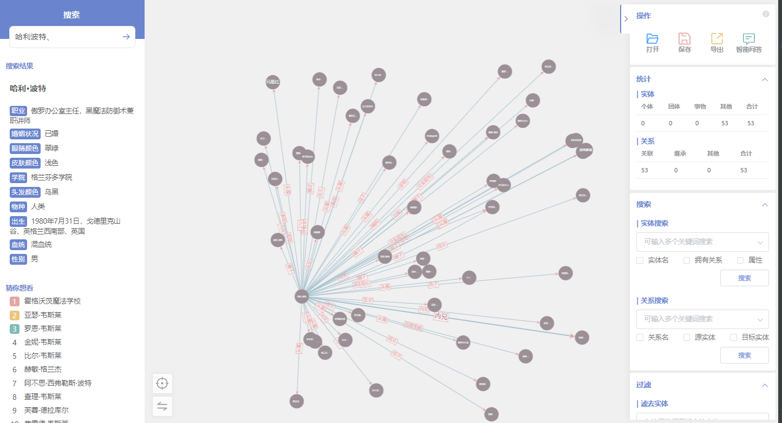
1. Keep it simple

Slide 11
2. 聚集同类的部件

Slide 12
3. 符合人的阅读习惯

Slide 13
Back-end

Slide 14
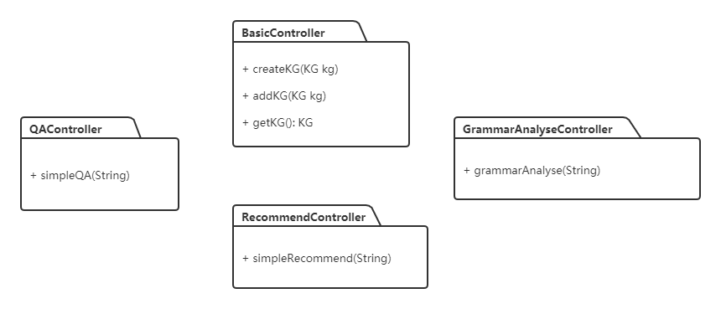
modules

Slide 15
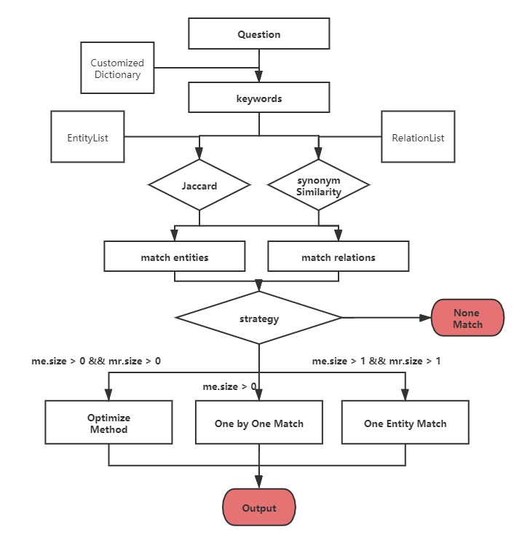
QA Service

Slide 16
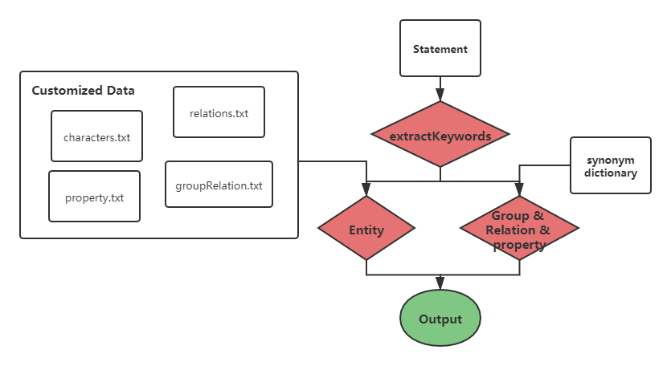
Recommend Service

Slide 17
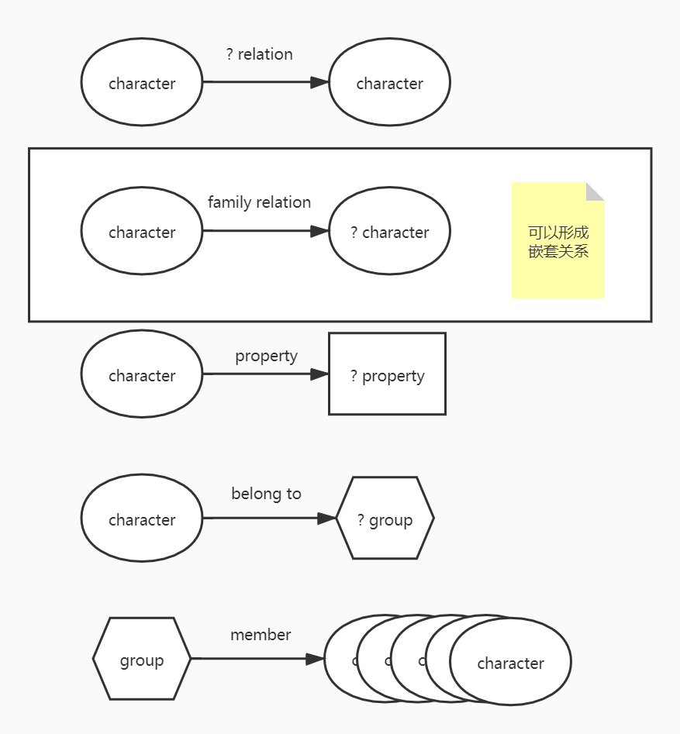
core questions

Slide 18
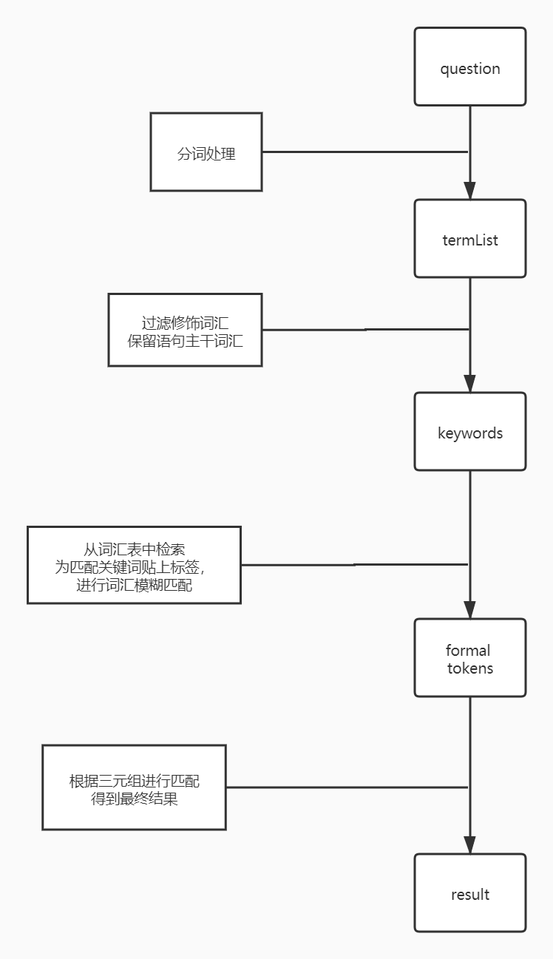
Grammer
Analyze

Slide 19
Else
work

Slide 20
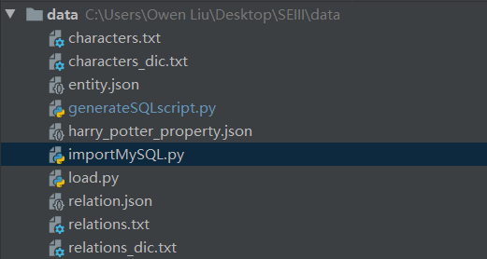
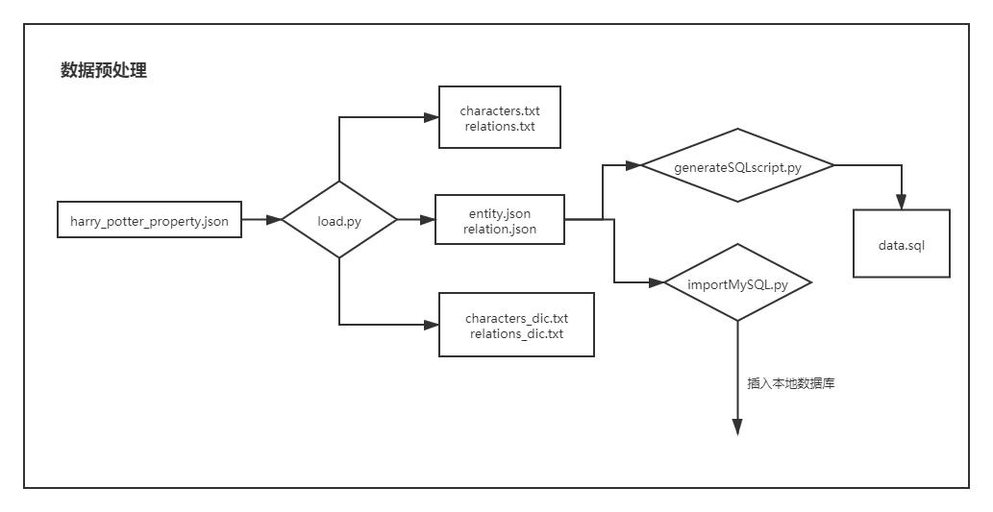
数据预处理

Slide 21
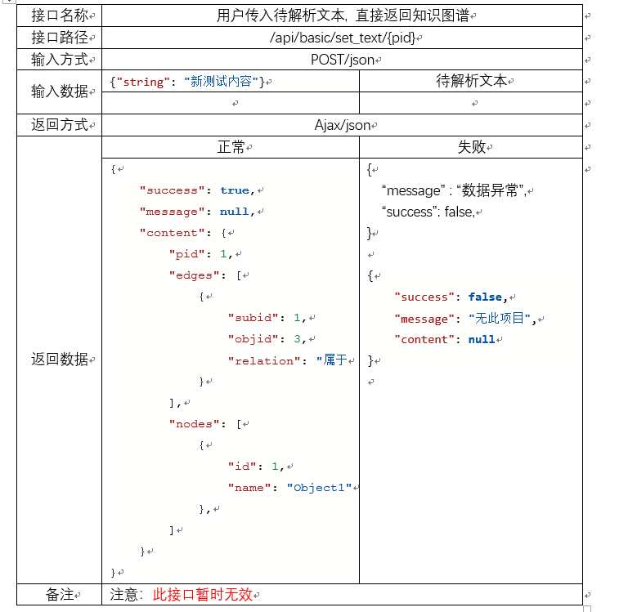
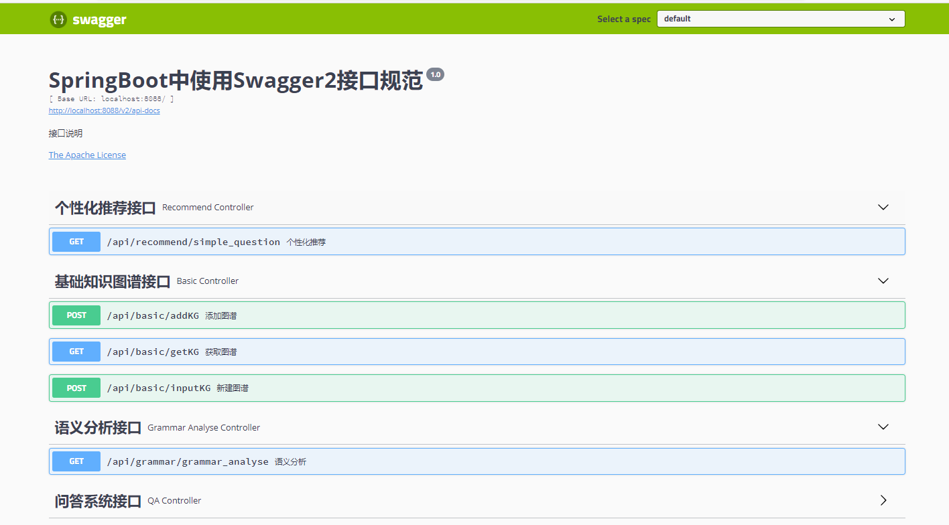
接口文档

